Slide 1

Convolutional neural network

Slide 2
What is CNN?
In deep learning, a convolutional neural network (CNN/ConvNet) is a class of deep neural networks, most commonly applied to analyze visual imagery.
It uses a special technique called Convolution. Now in mathematics convolution is a mathematical operation on two functions that produces a third function that expresses how the shape of one is modified by the other.
The role of ConvNet is to reduce the images into a form that is easier to process, without losing features that are critical for getting a good prediction.

Slide 3
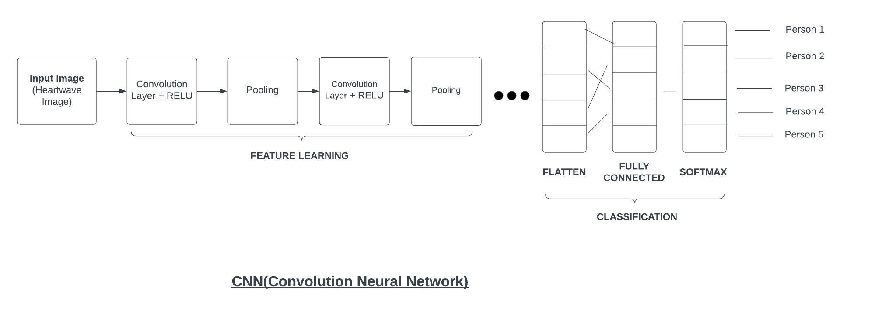

Slide 4
How it works
When you input an image in a ConvNet, each layer generates several activation functions that are passed on to the next layer.
The first layer usually extracts basic features such as horizontal or diagonal edges.
This output is passed on to the next layer which detects more complex features such as corners or combinational edges.
As we move deeper into the network it can identify even more complex features such as objects, faces, etc.
Based on the activation map of the final convolution layer, the classification layer outputs a set of confidence scores (values between 0 and 1) that specify how likely the image is to belong to a “class.”
For instance, if you have a ConvNet that detects cats, dogs, and horses, the output of the final layer is the possibility that the input image contains any of those animals.

Slide 5
What’s a pooling layer?
Similar to the Convolutional Layer, the Pooling layer is responsible for reducing the spatial size of the Convolved Feature.
This is to decrease the computational power required to process the data by reducing the dimensions.
There are two types of pooling so what we do in Max Pooling is find the maximum value of a pixel from a portion of the image covered by the kernel. Max Pooling also performs as a Noise Suppressant.
It discards the noisy activations altogether and also performs de-noising along with dimensionality reduction. On the other hand, Average Pooling returns the average of all the values from the portion of the image covered by the Kernel.
Average Pooling simply performs dimensionality reduction as a noise suppressing mechanism. Hence, we can say that Max Pooling performs a lot better than Average Pooling.

Slide 6
Flatten
Flattening is used to convert all the resultant 2-Dimensional arrays from pooled feature maps into a single long continuous linear vector. The flattened matrix is fed as input to the fully connected layer to classify the image.

Slide 7
Fully Connected layer
The Fully connected layer (as we have in ANN) is used for classifying the input image into a label. This layer connects the information extracted from the previous steps (i.e Convolution layer and Pooling layers) to the output layer and eventually classifies the input into the desired label.

Slide 8
Softmax
The softmax activation is normally applied to the very last layer in a neural net. The reason why softmax is useful is because it converts the output of the last layer in your neural network into what is essentially a probability distribution.

